Slide 1
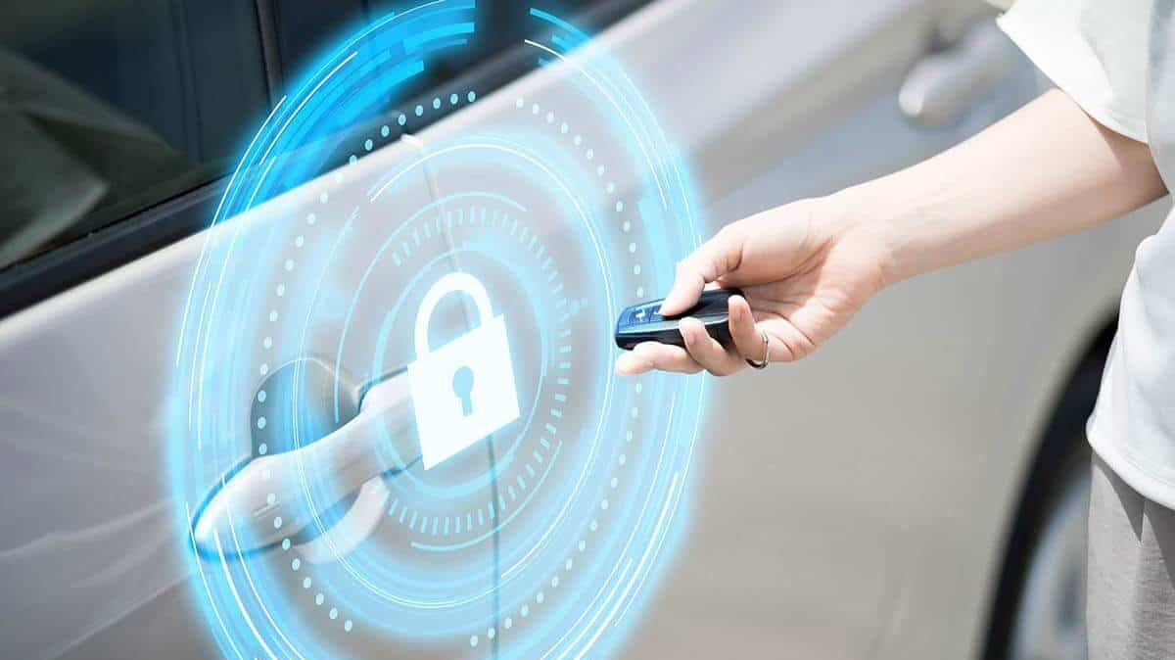
Security System & Drunk Driving Prevention
Dobra Paul
Rad Tudor-Andrei
Tat Dragos-Alexandru

Slide 2
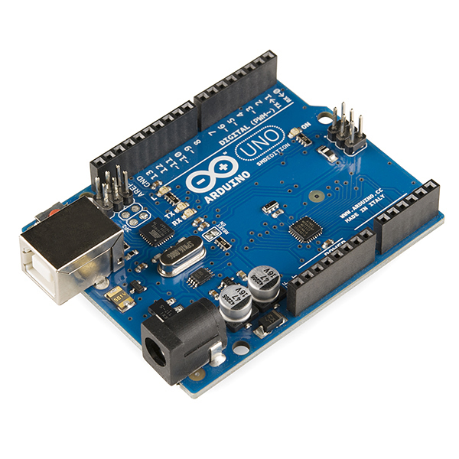
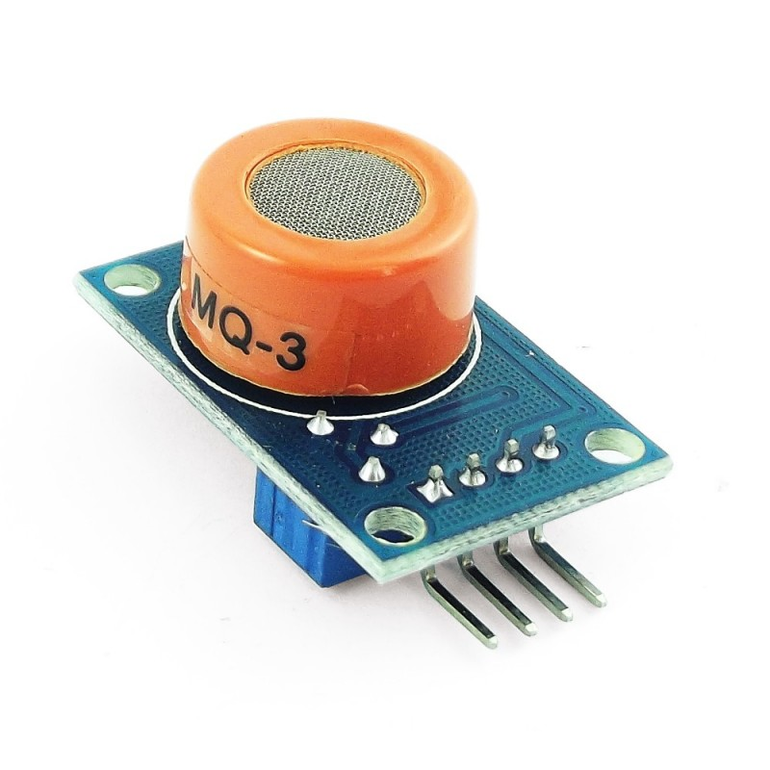
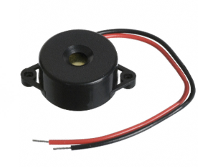
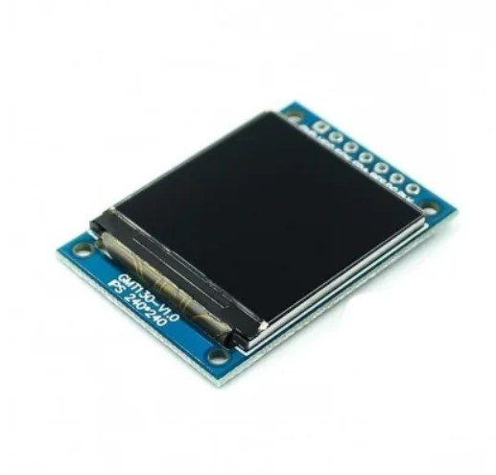
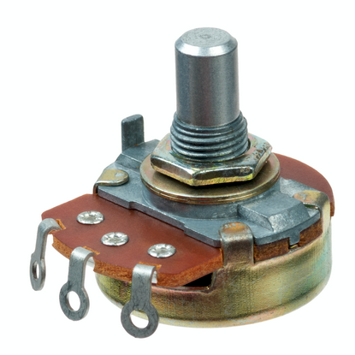
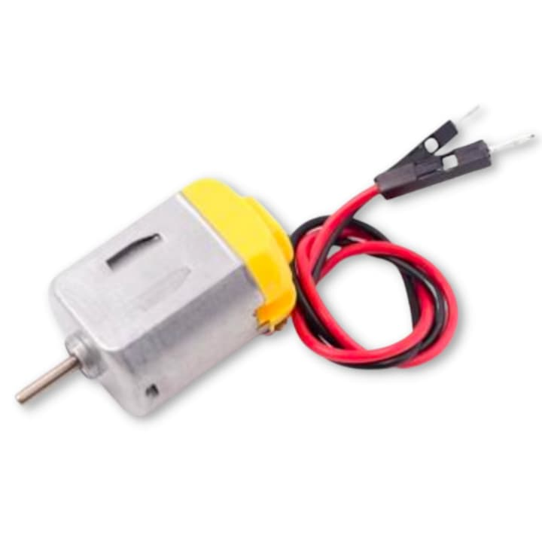
Hardware Setup
Arduino Uno Board
MQ3 Alcohol Sensor
Buzzer
RGB TFT_LCD
Potentiometer
Mini motor

Slide 3
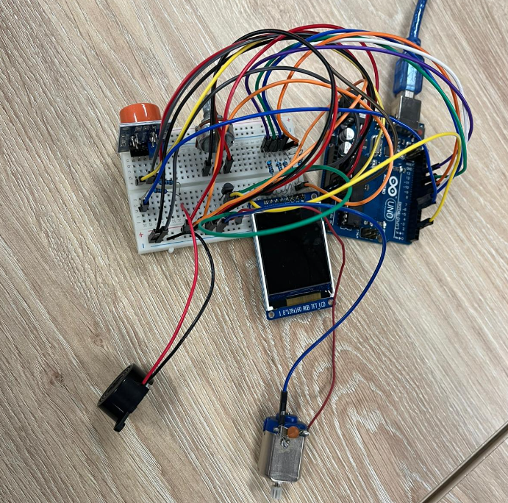
Connections
MQ3 sensor → Analog Pin A0
Buzzer → Pin 5
Display → Pins: 7, 8, 9, 11, 13
Potentionmeter -> Analog Pin A1
Motor -> Transistor controlled by pin 2

Slide 4
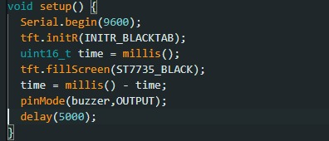
System Initialization
Display, Buzzer and Motor → OUTPUTS
Serial communication → 9600 baud rate
5 seconds delay → MQ3 stabilization

Slide 5
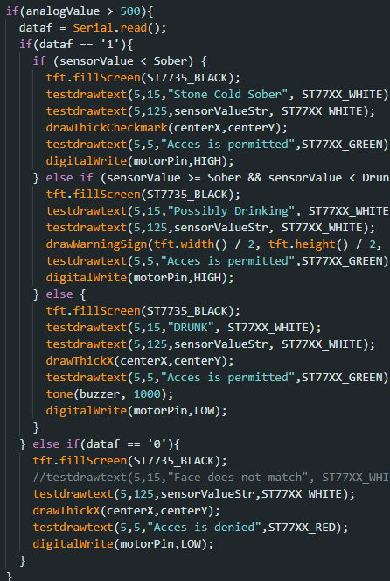
Main Functionality
1.First we verify the potentionmeter values (need to be over 500)
2.We read serialy the results from our face recognition program (python program)
3.We verify the value of the MQ3 sensor.
4.Status Determination:
-Sober(under 400), Legal limit(between 400 and 500), Drunk(over 500)
5. Feedback and Alerts:
-Display, Buzzer and Motor

Slide 6
Use cases
Personal breath analyzers.
Face Recognition system.
Integration in vehicles for drunk driving prevention.
Alcohol consumption monitoring in healthcare or workplace settings.

Slide 7


